Slide 1
Clinical and Endoscopic Characteristics May Sufficiently Predict the Absence of Adenomas in Diminutive Rectosigmoid Polyps to Allow a Diagnose and Leave Strategy
Cary Cotton and Jared Sninsky
BIOS 635 Final Project

Slide 2
Background
Applicable clinical guidelines recommend resection and pathology analysis of all polyps – expensive and prolongs sedation.
Hyperplastic polyps have no malignant potential, while adenomatous polyps have malignant potential and affect future surveillance intervals.
ASGE has proposed that any “diagnose and leave” modality for rectosigmoid diminutive polyps should provide a 90% or greater negative predictive value for adenomatous histology.
J

Slide 3
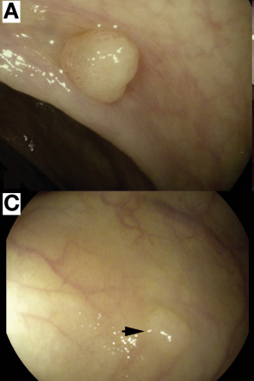
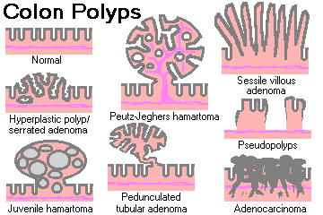
Polyps
J

Slide 4
Project Aim
We developed a machine learning algorithm derived from a large real-world clinical endoscopy database to predict the presence of adenoma among diminutive rectosigmoid polyps using a combination of clinical variables and concurrent endoscopic findings.
J

Slide 5
Methods
Adult patients, ages 18-85, undergoing screening or surveillance colonoscopy were identified within version four of the CORI database which spans 2008-2014.
Patients with any rectosigmoid diminutive (1-5mm) polyp pathology were included in the cohort undergoing routine average risk screening or surveillance colonoscopy.
Variables included age, race, sex, BMI, and smoking/alcohol status, years from last colonoscopy, most advanced lesion on last colonoscopy, hemorrhoid characteristics, diverticulosis presence and location, as well as polyp size, shape, and location.
J
Notes:
J

Slide 6
Machine learning approach
A priori reserved 40% testing fraction
Multiple imputation – five random imputations
Centered and scaled predictors
Tuning within a repeated cross validation framework
Tuning maximized model sensitivity for adenoma
Examined with and without resampling by SMOTE
Selected the leading model by NPV, AUC, and the proportion ruled out
Threshold by maximum kappa 5:1 upweighting of false negatives
Testing the classifier with and without threshold in reserved fraction
Notes:
J

Slide 7
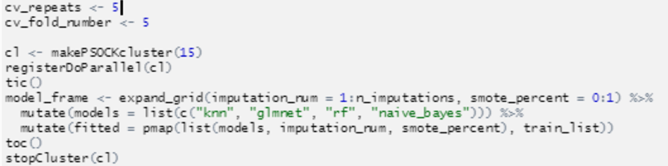
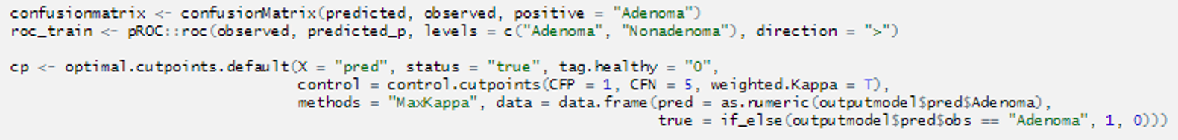
Code highlights
Notes:
C

Slide 8
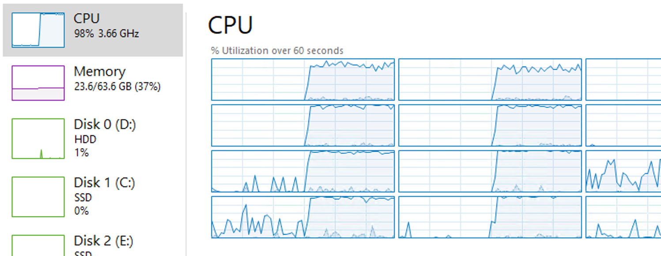
The training process was CPU intensive.
Notes:
C

Slide 9
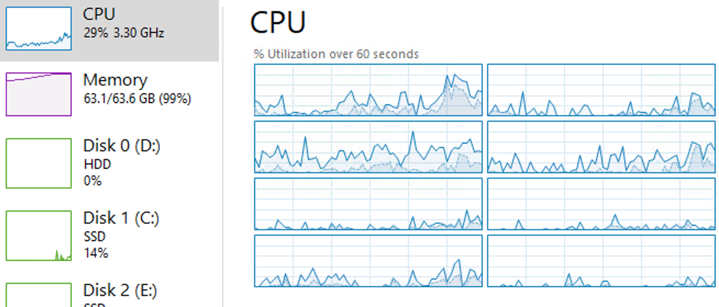
Summarizing the models was less CPU intensive and more memory intensive.
Notes:
C

Slide 10
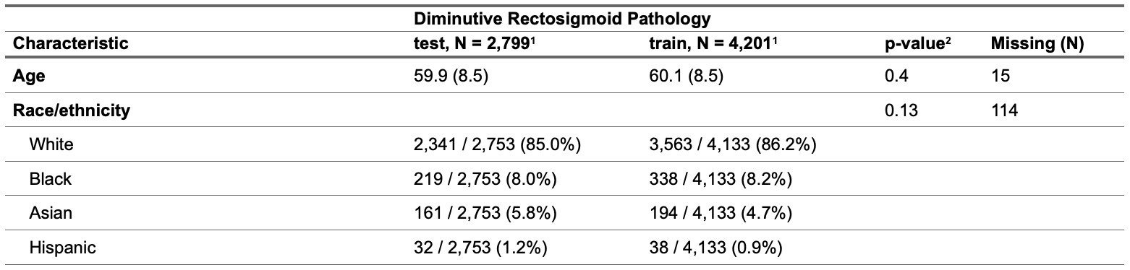
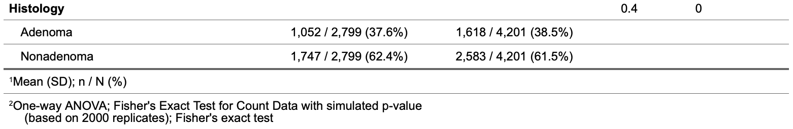
Results – Descriptive
J
Notes:
J

Slide 11
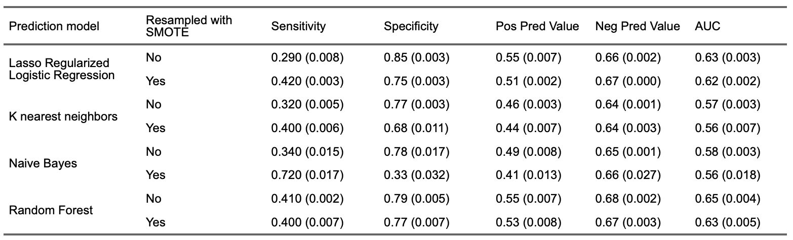
Overall and 50% threshold model performance characteristics
J
Notes:
J

Slide 12
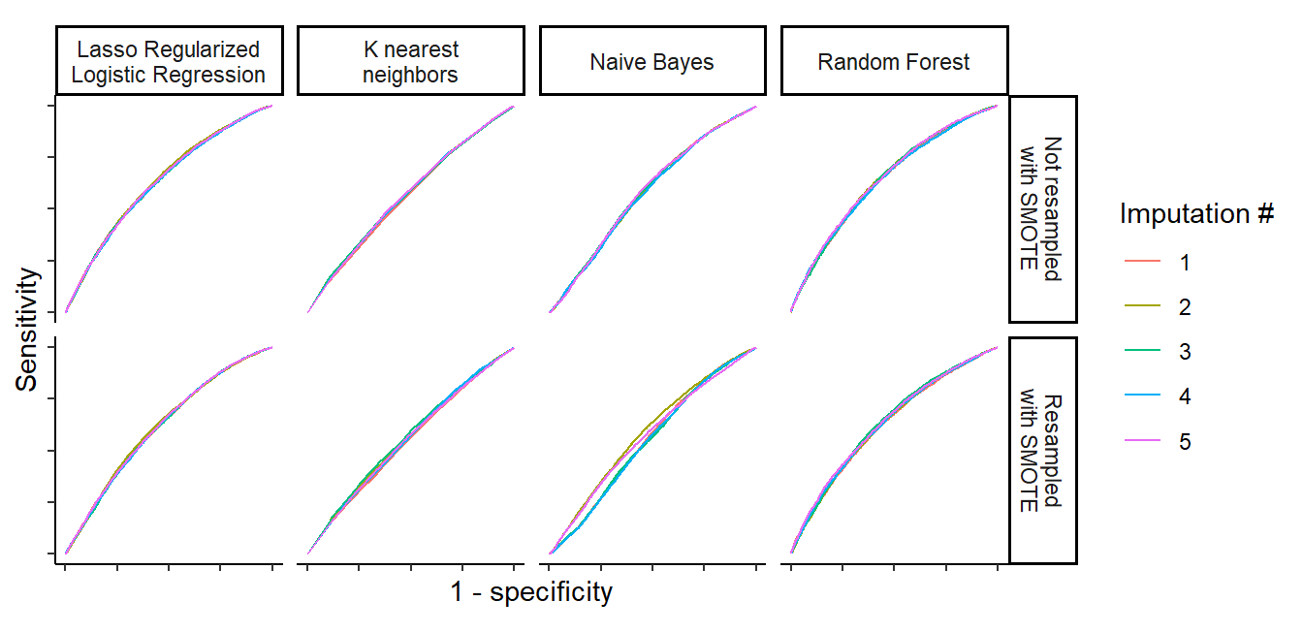
Receiver-operator characteristic curves
J
Notes:
J

Slide 13
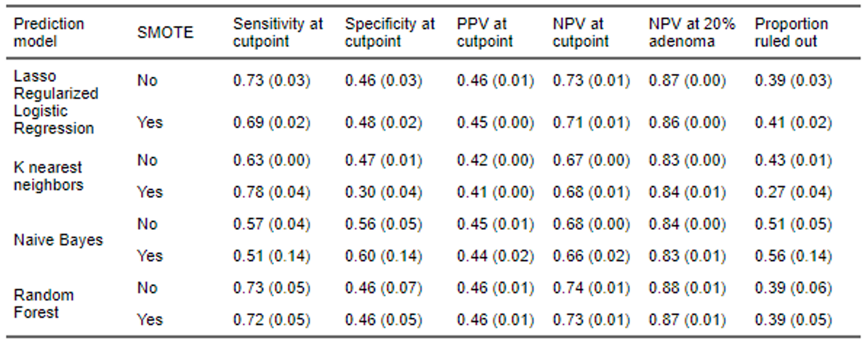
Model characteristics at the optimal threshold
Notes:
C

Slide 14
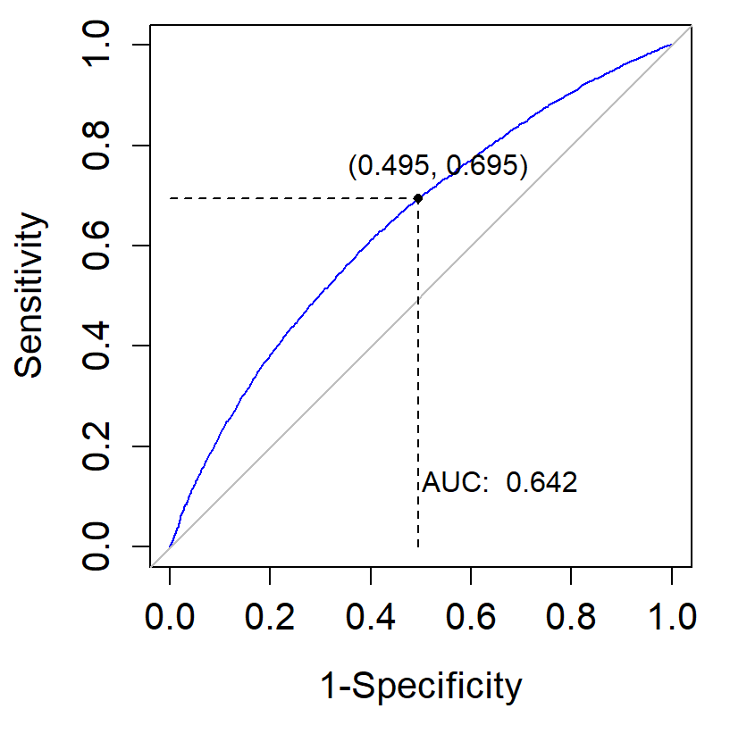
Threshold optimization(training)
Notes:
C

Slide 15
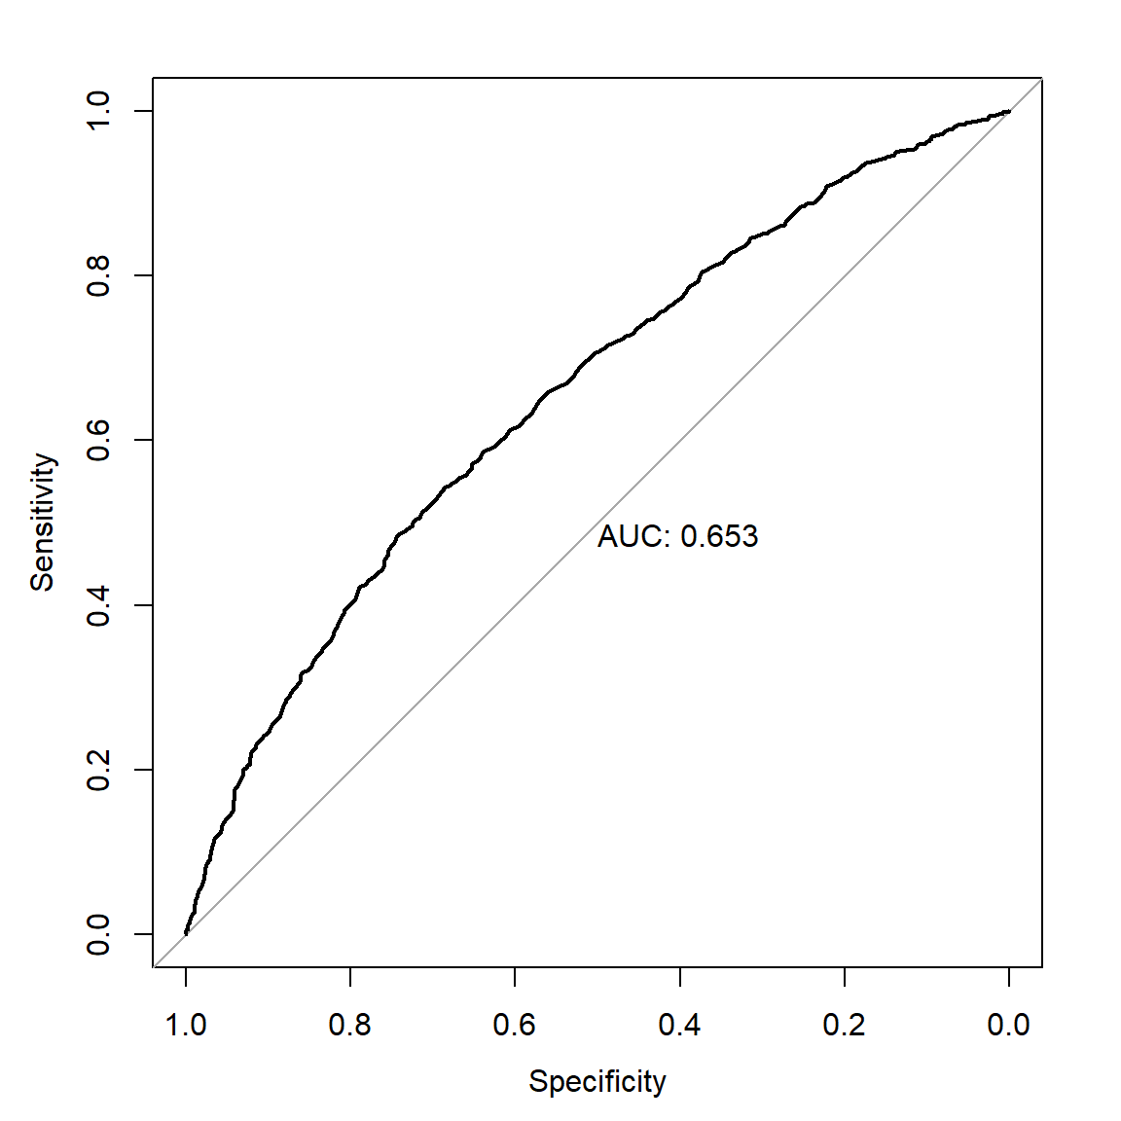
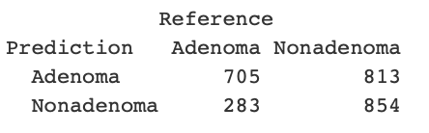
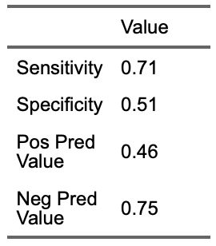
Testing performance
Notes:
C

Slide 16
Discussion
Based on rudimentary demographic and endoscopic findings, without any imaging or video data, we were able to achieve a negative predictive value of 68% for diminutive rectosigmoid adenomas in a held-out testing cohort, 88% after adjusting for prevalence.
Artificial intelligence is increasingly applied to gastroenterology, ranging from video polyp detection to cross-sectional imaging analysis.
We have demonstrated that clinical/endoscopic data alone can lead to surprisingly accurate diagnostic models and merging these models with other modalities will further improve diagnostic accuracy and clinical care in gastroenterology.
J
Notes:
J

